Slide 1
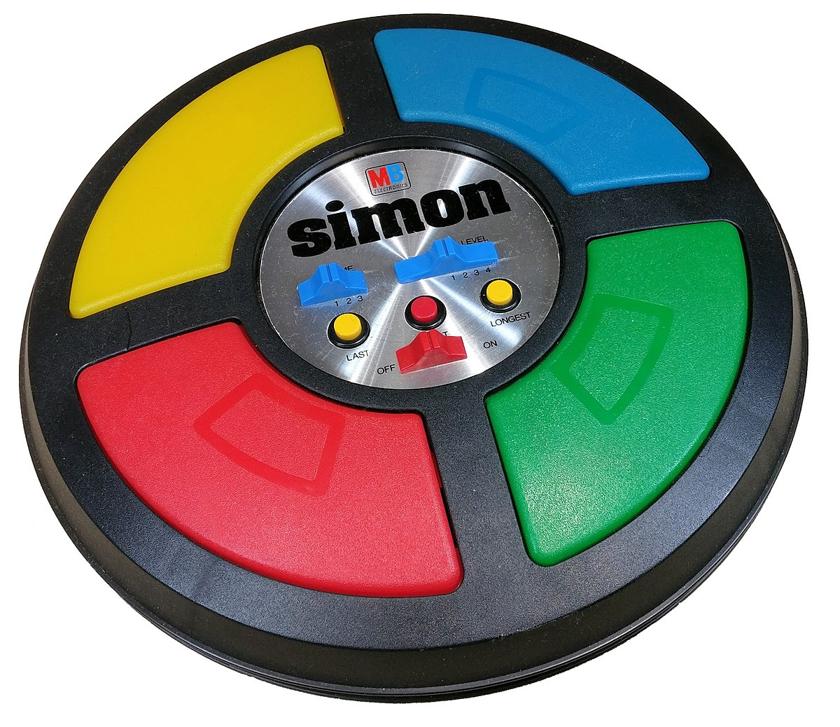
Simon Says Game
Project By: Karim Smires

Slide 2
Concept Inspiration
Nostalgia
Played Simon Says as a kid
Poor Memory
Memory game with poor memory seems ironic
True to Source
“Standalone” device that works like the original
Easy to Comprehend
Easy to outline FSM, easy to explain to others, and easy to understand

Slide 3
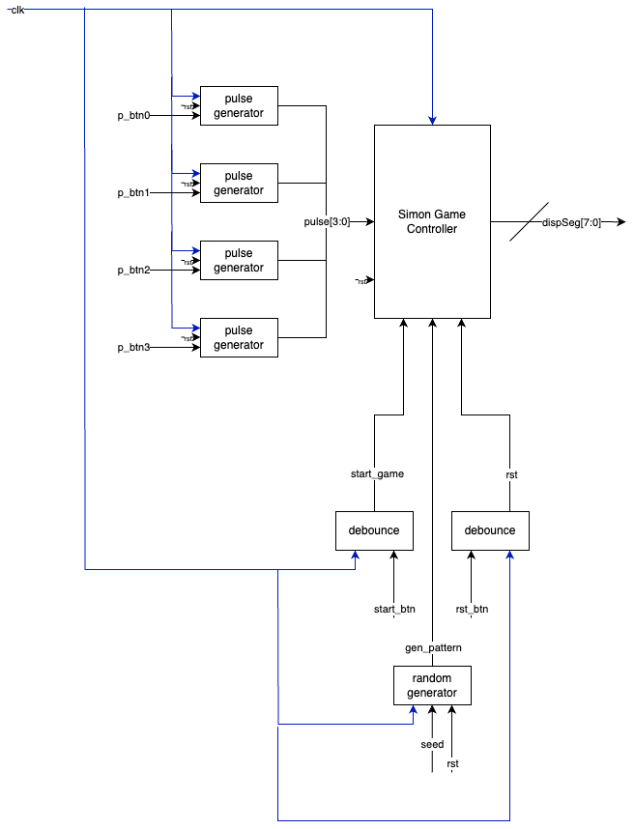
System Description
Internal Components
Simon Says Game Logic Controller – controls all game logic and timing
Debouncer – generates debounced signals for start and reset
Pulse Generator – ensures that registers are not overloaded
Random Number Generator – generate random numbers for game logic
External Components
Button PMOD – additional buttons for game functionality
Seven Segment Display PMOD – display random generated numbers to users
Processes
Game Logic Process – move between states to generate, display, receive, and verify user input
Seed Randomizer – randomize seeds to ensure better randomization
SSD Update – update SSD with display register values

Slide 4
System Description – Finite State Machine
Idle
Initial start state – remain in this state until user input starts the game, or return to this state when user resets or loses at any level
Gen
Generate state – generate random numbers using the random number generator and save them to the game register, incrementing the game level as needed
Display
Display state – display a random number for half a second, repeating the process until all numbers in the game register are displayed
Input
User input state – wait for the user to input an equivalent number of inputs as there are generated random numbers in the game register
Check
Input verification state – verify that the game register and user inputs are matching values
If inputs match: move to the win state
If inputs do not match: move to the lose state
Win
User win state – transition to the Gen state again after one second
Lose
User lose state – transition to the Idle state again after one second

Slide 5
Problems Solved
How to add random number generation to VHDL and ensure unique patterns?
Custom built component to introduce some semblance of randomization with a given set input – random seed
Increment the random seed to add additional randomization to the game logic
How to ensure that registers only store a single user input without filling up additional space?
Custom built component to generate a pulse after being passed an input value
Pulse generator can be set to work on rising or falling edges of inputs, allowing us to pass a single value in a clock cycle almost instantaneously after a user lets go of a button
How to make game states clearly visible to users?
Seven segment display clearly shows numbers in a large, readable format as opposed to onboard LEDs or OLED
Use display to indicate when users can input values, or turn off display when device is “not on” and must be reinitialized

Slide 6

Application, Market, and End Users
Application Space
Children's Entertainment – memory game that can be targeted to lower aged audiences
Medical – memory aspect is potentially useful for psychological or mental facilities
Market
Parents – purchasing toys to keep their children distracted in an educational or constructive way
Children’s Medical Centers – potentially beneficial game that can be targeted and designed for children due to low complexity
End Users
Children – with 16 levels and randomization, children who enjoy challenges will find a unique challenge each time the game is turned on, played, and reset

Slide 7
Implementation Challenges and Choices
Challenges
Only tested on Zybo 7000; future implementations need to be tested on lower-end, cheaper, and dedicated boards
Choices
Off the Shelf Parts
Custom components not required – all PMODs and boards are publicly available for purchase
Single Purpose Processor
Embedded system design – single function ensures game is designed with all processor limitations in mind
Soft-core Processor
Zybo 7000 – future implementations will be hardware implementations to avoid complexities of soft-core processor
Stock of Labs
All considerations for the project had to be made with the Rutgers inventory kept in mind

Slide 8
Summary
Inspiration and Description
2000s nostalgia – childhood game brought to life through VHDL instead of some high-level software language
Simon Says Memory Game – random number from a set of four possible options, with users tasked with inputting the sequence given to them
Successful Demonstrable Design
Custom built components to ensure functionality of the FSM design
Multiple prototypes designed from real user feedback to ensure a playable game
Project works to the given specifications and with incredible efficiency, allowing for more functionality or simpler hardware to be implemented
Version 2.0
“Dockable” Nintendo Switch-like design – add video output for scaling the display for players
Audio cues – audio paired to all unique functionality and inputs of the game, allowing for greater accessibility for players
Limitations
Timing of designer, not of the board – small window of delivery meant version 1.0 is more basic than previously intended, despite meeting requirements of the assignment
IO limit creep-up – the more features we add, the more we pass the current 15% of IO utilization, potentially causing future issues
Mobility – no on-device battery means the device is stuck to a computer no matter what

